Slide 1
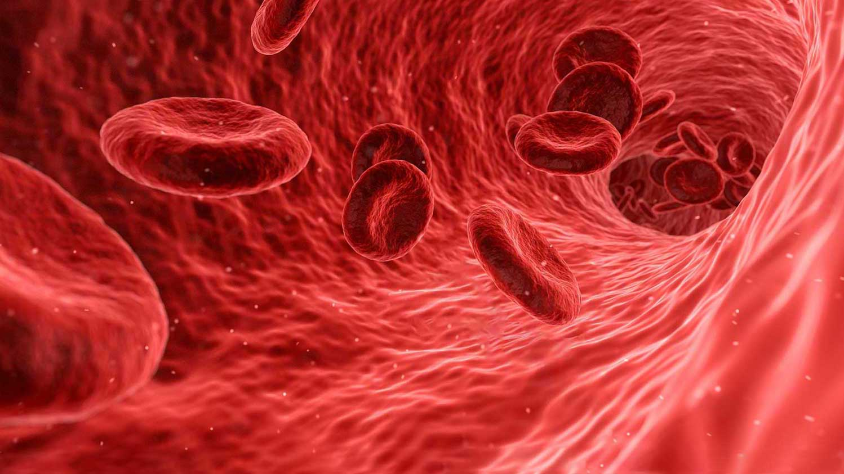
A Secure Cloud Computing Based Framework for the Blood bank

Slide 2
Presented By:
RANJANA K
Roll No: 31
Presented To:
Guide: Ms. JOICE T
Scrum Master: Ms.SENU ABI

Slide 3
BLOOD BANK
A blood Bank can be defined as a bank or storage place where blood is collected, preserved and used whenever needed or demanded. Over the years, blood banking has helped save countless lives. Today, about 13.6 million units of blood are donated per year. About 36,000 units of blood are needed each day. Blood banks can safely store blood donations, and process and screen blood to ensure safety for all. A blood bank ensures that hospitals have a safe, reliable blood supply for patients in need. You can help meet supply demands by scheduling your donation today. Your donation may even help save more than one life.

Slide 4
OBJECTIVE
The main aim of creating cloud-based blood bank system is to make the blood available on time to the people, even in emergency situations. With the help of this project, the user can be able to view information about every entity related to blood bank i.e. hospitals, donors, a location of another blood bank etc.

Slide 5
INTRODUCTION
Blood contribute to 7% of total body weight, so to maintain the specific amount of blood in the body is necessary for a human to survive. Studies show that for every moment, to save their life someone needs blood. Especially in the rural area the facility provided by the blood bank system is not appropriate due to lack of availability of information and amount of blood in one specific blood bank. The main idea behind the paper is, to improve the blood bank system working, management etc. , with the help of cloud computing technology. The project provides a platform using which the information about the donor, its location, nearby blood bank etc are available for the requester requesting it. Location can be made visible to the user by the use of GPS technology. The paper includes brief information about working with the blood bank management system, its services and various technologies like cloud computing, android application, web technology etc.

Slide 6
The entities involved in the cloud-based blood bank management system are as follows:
• Requester: The person who needs the blood from blood bank because of accident, disease, surgery etc.
• Donor: The person who is healthy enough to donate the blood to the blood bank for saving a person's life is the donor. The person having appropriate body weight, hemoglobin and no acute or chronic disease can become the donor.
• Blood Bank: Blood bank can be simply defined as a section of the blood bank where the blood is stored and tested, to reduce the risk at the time of transfusion
Cloud computing technology is used in this application because cloud computing is the latest and efficient way of server-based computing. Cloud provides good backup recovery, flexibility, and increased security.

Slide 7
EXISTING SYSTEM
The information collected from the blood bank and hospitals describe the working of the blood bank system. Blood cannot be produced artificially in the laboratory. Thus to satisfy an increased need of blood, blood collection should be increased. Various promotional activities are conducted by the blood bank and hospitals to enhance the donor to donate blood, as the amount of blood in the bank depends on a number of donors. Information like phone number, email, address etc is collected by the donor and stored after they complete their blood donation. The system that exists today is dependent on paperwork. To donate and receive the blood from the bank, the donor and receiver has to fill the form consisting of the basic details

Slide 8
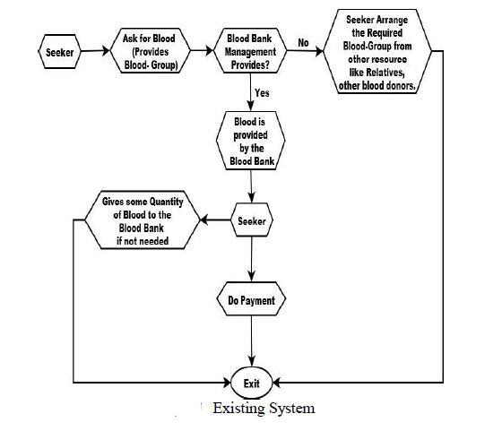

Slide 9
PROPOSED SYSTEM
To get started with our application user need to first download the application. Once the application is downloaded user will be provided with two options on screen. First is, log in and second is, sign in option. If the user is already registered, then he/she can go for the first option and login. If the user is using the application for the first time then he/she has to create an account by providing details like name, address, contacts, date of birth, blood group, and email id. The user has to upload his/her license or id proof on which blood group is mentioned. The user can anytime update his/her information. After registration is done the user can access the application, provided the user has internet access.
Once the user is signed in he/she will be provided with various options like:
• Blood camp
• Search donors
• Search blood banks
• Request for blood
• Nearby hospital
• View notification
• Emergency contact details

Slide 10
Just by selecting any of the options mentioned above he /she will get the information accordingly like information about blood camp, the nearby hospital, any notification etc.
All the detail of the blood donor, hospital is stored in database. Security care is taken; the confidential data can only be access by the administrator. Data of each user is stored safely on cloud . By using this application the user will not have to search for the blood in case of emergency and can directly get the detail of required blood donor by accessing this application.

Slide 11
Modules
Add and View Donors
Add and View Blood Bank
Request for Blood

Slide 12
THANK YOU

